Slide 1
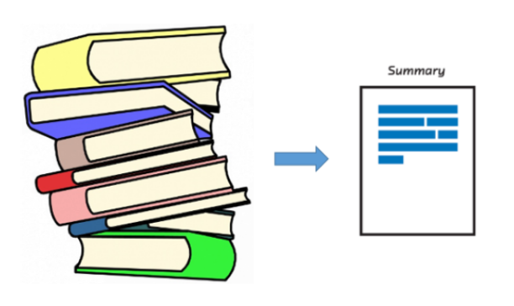
END TO END SummArization tool

Slide 2

TOPIC:- End-End Summarization Tool using NLP
Submitted By:-Prayag Gavshinde Under Supervision of
Raghav Agrawal Prof. Kapil Sahu
Rishabh Rathore
Rishi Somani
Sambhav Jain

Slide 3
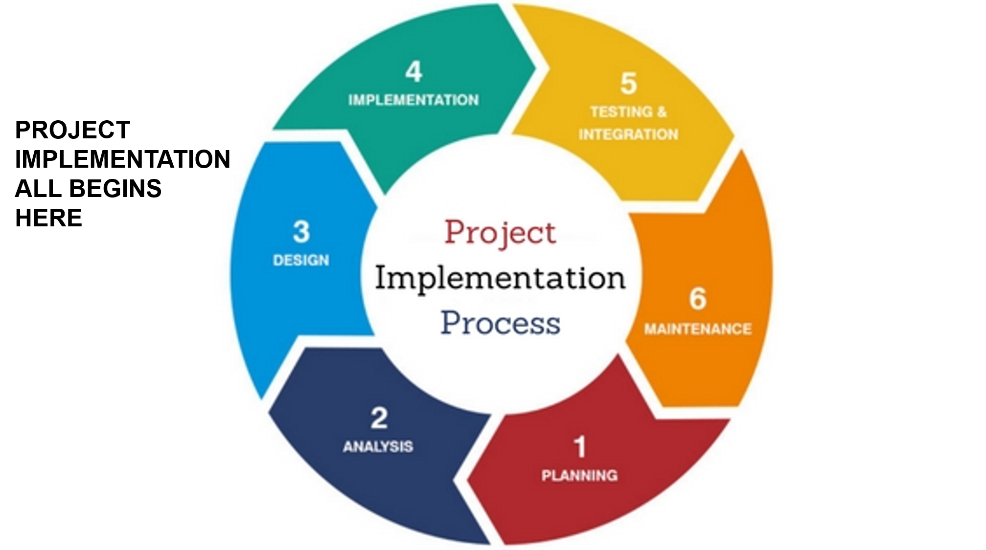

Slide 4
PROJECT PRESENTATION OUTLINE
Abstract
Problem Statement
Survey of Existing System
Solution Proposed
Scope of Project
Techniques Used
Implementation
Requirement
Limitations
Conclusion

Slide 5
ABSTRACT
Machine learning is a branch of artificial intelligence concerned with the creation and study of systems that can learn from data. In this project, Automatic text summarization is basically summarizing the given paragraph using natural language processing and machine learning. There has been an explosion in the amount of text data from a variety of sources. This volume of text is an invaluable source of information and knowledge which needs to be effectively summarized to be useful. In this review, the main approaches to automatic text summarization are described. We review the different processes for summarization and describe the effectiveness and shortcomings of the different methods.

Slide 6
PROBLEM STATEMENT
People need to learn much from texts. But they tend to want to spend less time while doing this. Article writing is a cumbersome task which requires lots of research on a specific topic through various resources. Many times it happened people want to read research paper, documents but got distracted by length and non-relevant sentences. This makes a need of Automatic Text summarization which can help precisely to deal with problem and save the time to learn from text data.

Slide 7
SOLUTION PROPOSED
The solution we proposed is well suited for extracting summaries of each kind on a single interface where user enjoys all the benefits along with voice clone feature to listen as well as read.
The major functionality that the project enjoys are
Summarize large documents(PDFs, DOCs, txt file)
Summarizing article(blogs) through URLs
Extracting important topics document talk about
Image captioning

Slide 8
SURVEY OF EXISTING SYSTEM
No. | Existing system/website/software | Features | Disadvantages | Limitations/Gaps
1 | TLDRthis (website) | Summarize any article through URL or pasting text | summarizing documents by uploading them from the local system is not possible. | 1.Cannot summarize pdfs. 2.only applicable for articles or blogs through links.
2 | Resoomer(Website) | Summarize text for everyone By copy-paste content. Options for downloading generated summary in pdf of any doctype. | summarizing documents by uploading them from the local system is not possible. | 1. Cannot summarize pdfs. 2.only applicable for text content.

Slide 9
Scope of Project
SCOPE OF PROJECT
The main Object of project is to understand Natural Language processing working in depth and implement summarization tool.
Tool is as powerful that could accept text from any source like pdf, doc, txt or online article link and even can write or copy-paste content.
Summary user retrieves should be well formed that describe the complete document.
User can listen, download, copy summary easily as his/her own pace.

Slide 10
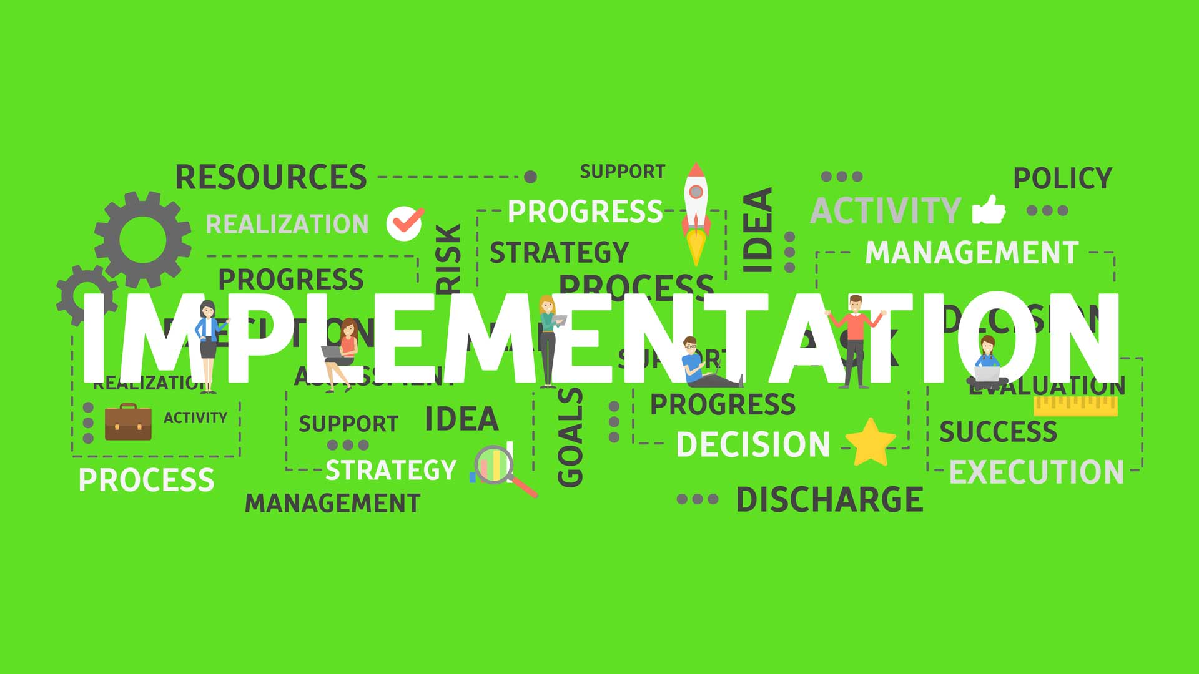

Slide 11
Techniques used
Deep Learning: Deep Learning is a subfield of machine learning concerned with algorithms inspired by the structure and function of the brain called artificial neural networks.
CNN:A CNN is a class of deep neural networks widely used in image classification, object detection, and all other computer vision tasks. CNN is inspired by the connectivity pattern of the neurons in the human and animal visual cortex.
Natural Language Processing:Natural Language Processing (NLP) is a field in Computer Science that focuses on the study of the interaction between human languages and computers (Chowdhury, 2003). Text summarization is in this field because computers are required to understand what humans have written and produce human-readable outputs.

Slide 12
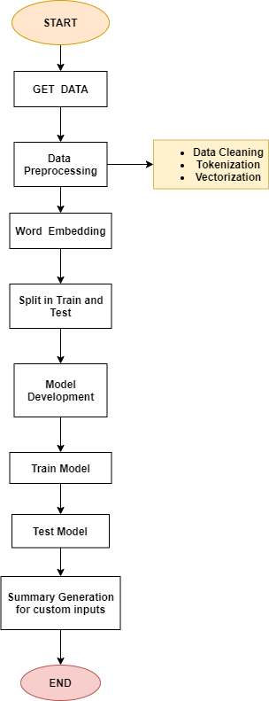
System Architecture for Abstractive Approach

Slide 13
MODELs USED
We have used different algorithms to achieve different solution and combine each model on a single interface using python web framework Flask.
LDA - Used for Topic Modelling
T5 Transformer - A Text to Text Transformer from Google used for Text summarization in required format
VGG16 - A CNN algorithm used to train on Images for predicting Captions on Image(Image Captioning)

Slide 14
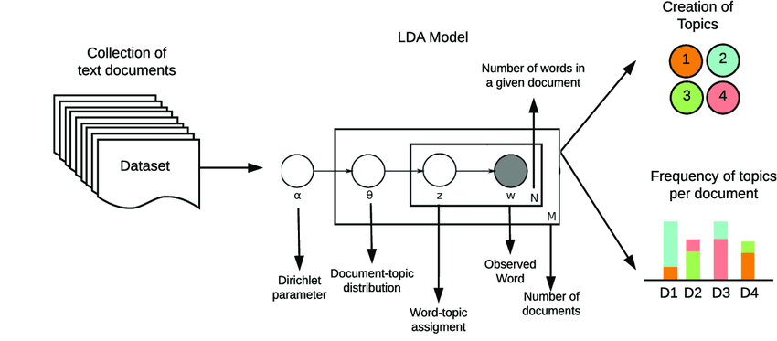
Topic Modelling Explanation using LDA

Slide 15
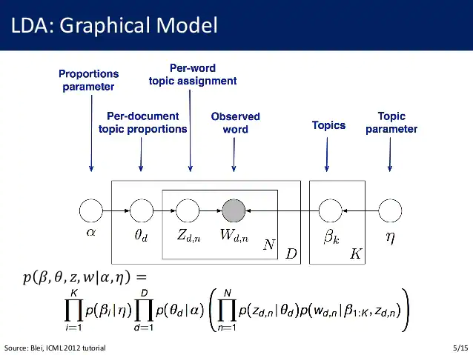
LDA Graph Model

Slide 16
T5 Transformer(Text-To-Text Transformer)
The T5 (Text-To-Text Transfer Transformer) model is a unified framework that converts every language problem into a text-to-text format.
It handles a wide variety of tasks, such as translation, classification, QA, summarization, by treating all tasks uniformly as taking some input text and outputting some text where the task type is embedded as descriptors in the input.
The input sequence is fed to the model using input_ids. The target sequence is shifted to the right, i.e., prepended by a start-sequence token and fed to the decoder using the decoder_input_ids. In teacher-forcing style, the target sequence is then appended by the EOS token and corresponds to the labels.

Slide 17
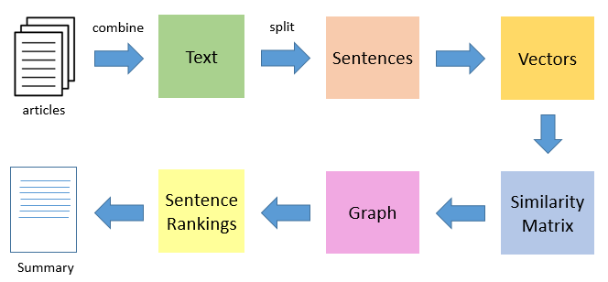
Block Diagram of Text Summarization

Slide 18
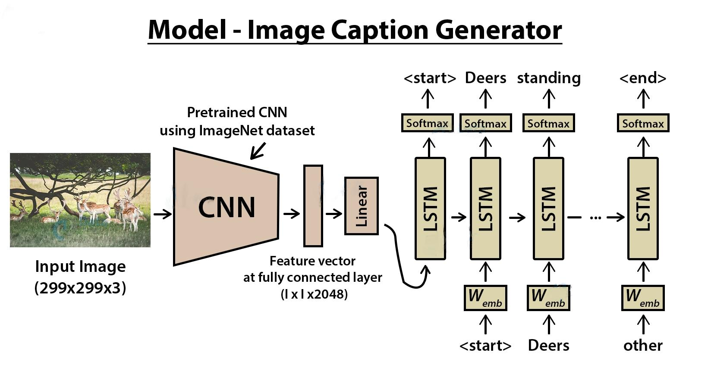

Slide 19
REQUIREMENT
FUNCTIONAL REQUIREMENTS:-
Large Chunks of Text.
Web Page Urls.
Text Rank Algorithm.
Word2vec Representation(Glove Algorithm)
Similarity Matrix.
Transformer Package
NON FUNCTIONAL REQUIREMENTS:-
Reliability.
Performance
Usability.
Platform independent
Supportability.

Slide 20
HARDWARE REQUIREMENTS:-
Modern Operating System:
Windows 7 or 10
Linux: RHEL 6/7, 64-bit (almost all libraries also work in Ubuntu).
4 GB RAM
x86 64-bit CPU (Intel / AMD architecture) .
SOFTWARE REQUIREMENTS:-
​Python IDEs :
VS Code.
Anaconda 3(64 bit).
NLP (NLTK)
Text to speech
Flask
Jupyter-Notebook.
Cloud Database(Heroku/AWS).

Slide 21
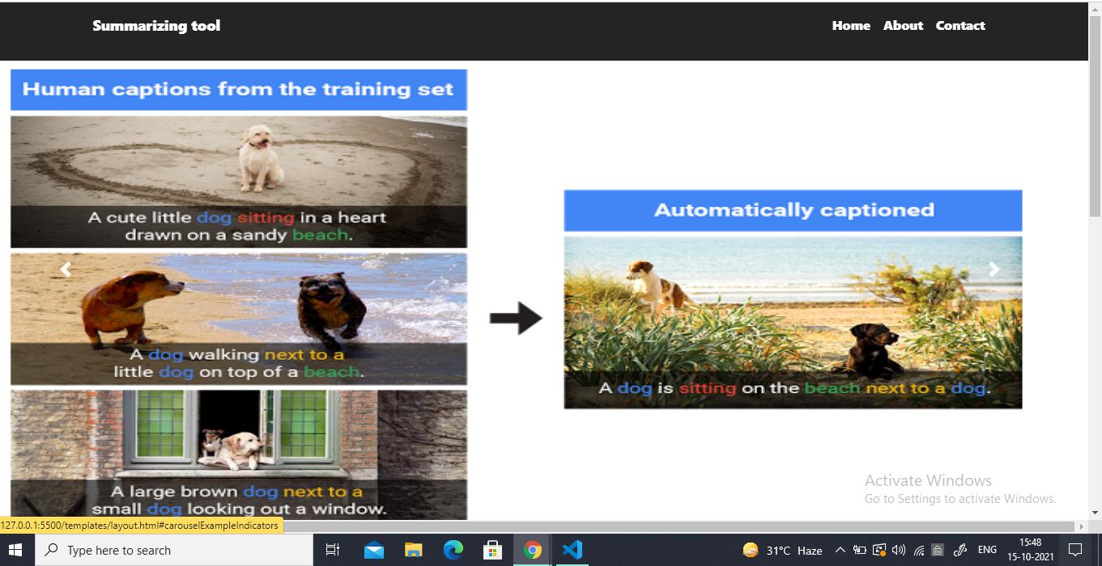
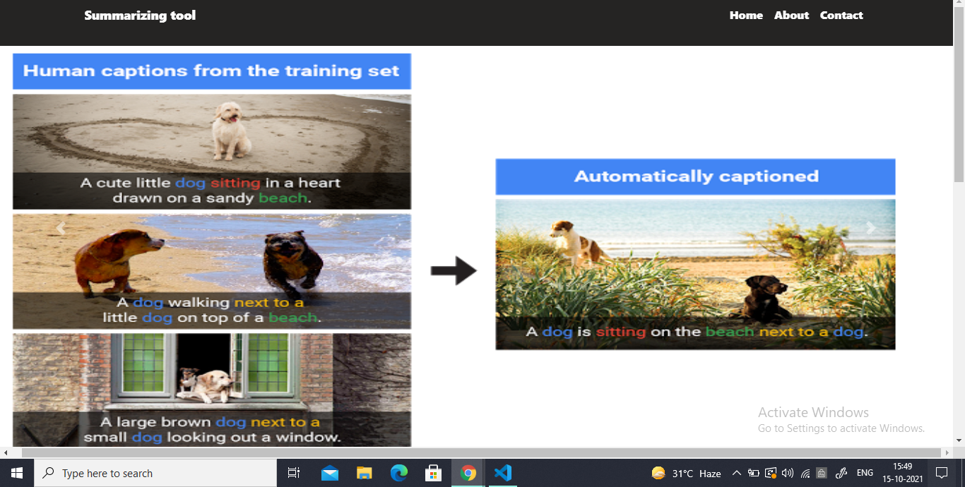
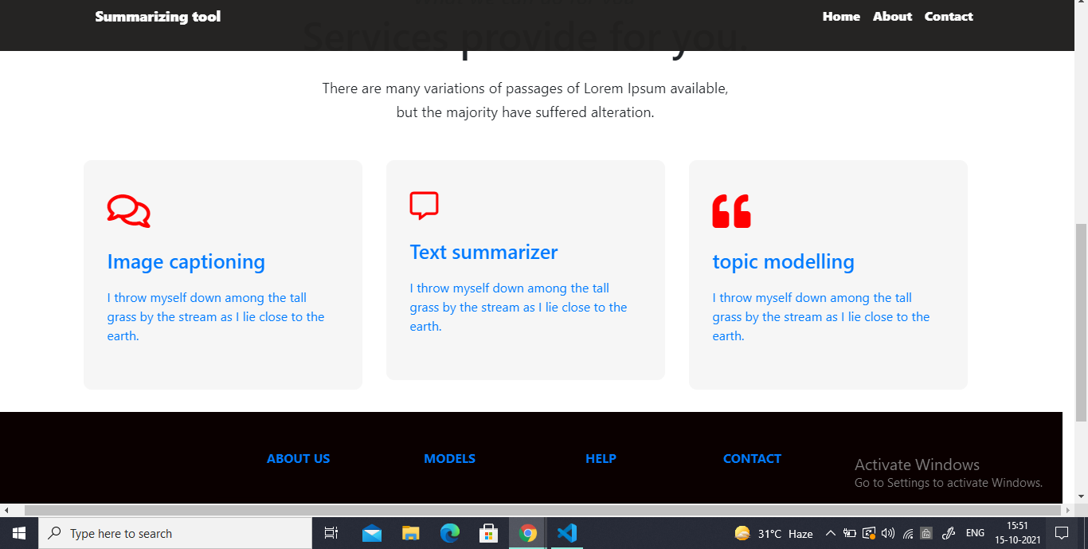
SCREENSHOTS

Slide 23
LIMITATIONS
Require Stable Internet Connection as it’s working on the web.
Multiple documents or Multiple Images cannot be summarized at a time.
Image captioning Model trained on a dataset of most commercial and used Images. There is a chance to not generate captions on rare Images.

Slide 24
CONCLUSION
Automatic text summarization is an old challenge but the current research direction diverts towards emerging trends in biomedicine, product review, education domains, emails, and blogs.
Automated summarization is an important area in NLP (Natural Language Processing) research. It consists of automatically creating a summary of one or more texts.
As with time the internet is growing at a very fast rate and with it data and information is also increasing. It will be difficult for humans to summarize large amounts of data. Thus there is a need for automatic text summarization because of this huge amount of data.

Slide 25


